Slide 1
Employee Data Analysis using Excel
STUDENT NAME: Sri chamundeeswari .N
REGISTER NO: 122204058
DEPARTMENT: B.Com (corporate secretaryship )
COLLEGE : Shri Krishnaswamy college for women

Slide 2
PROJECT TITLE
Employee Gender Analysis Using Excel

Slide 3


AGENDA
Problem Statement
Project Overview
End Users
Our Solution and Proposition
Dataset Description
Modelling Approach
Results and Discussion
Conclusion
3/21/2024 Annual Review

Slide 4

PROBLEM STATEMENT
1. Diversity and Inclusion: Tracking gender helps companies monitor and improve gender diversity, ensuring a more inclusive workplace.
2. Equal Opportunities: Identifying gender helps companies ensure equal opportunities for all employees, regardless of gender.
3. Gender Pay Gap Analysis: Analyzing gender helps companies identify and address pay disparities between men and women.
4. Talent Management: Understanding gender demographics helps companies tailor talent management strategies to attract, retain, and develop employees.

Slide 5

PROJECT OVERVIEW
.
1. Project Management: Understanding project views helps companies manage projects more effectively, ensuring timely completion and meeting objectives.
2. Resource Allocation: Identifying project views enables companies to allocate resources efficiently, assigning the right personnel and materials to each project.
3. Progress Tracking: Project views allow companies to monitor progress, identify bottlenecks, and make adjustments to stay on track.
4. Stakeholder Management: Companies can communicate project status and updates to stakeholders, ensuring transparency and trust.

Slide 6

WHO ARE THE END USERS?
1 .Employees
2 . customers
3 . Client - facing team
4 . IT and technical teams
5 . Management and leadership
6 . Remote workers

Slide 7

OUR SOLUTION AND ITS VALUE PROPOSITION
"PIVOT often refers to a strategic shift or adjustment in business project management, or personal strategy. In a business context, a "pivot" involves changing direction or altering a company's strategy based on market feedback or performance. This might include altering product offerings targeting a new customer segment, or modifying business models to better align with market demands. The goal of a pivot isusually to improve outcomes address challenges or capitalize on new opportunities for growth and success

Slide 8
Dataset Description
◆◆Employee = kaggle
◆◆Nine Feature
◆◆Employee I'd
◆◆Name=text
◆◆Data number
◆◆Employee type
◆◆Performance level
◆◆Gender
◆◆Female and male
◆◆employee rating numerical

Slide 9

THE "WOW" IN OUR SOLUTION
1. Unbiased Hiring Practices Utilize neutral language in job postings and implement blind hiring to minimize bias
2. Training and Education: Organize workshops on gender sensitivity, unconscious bias, and diversity.
3. Equal Pay and Benefits Ensure fair compensation and benefits for all employees regardless of gender
4. Support Networks Establish employee resource groupsfor women and non-binary individuals
5. Rexible Work Arrangements Offer adaptable work arrangements to accommodate different needs
6. Leadership Opportunities: Encourage women and non-binary individuals to take on leadership roles 7. Safe and Inclusive Workplace: Foster an environment where
everyone feels comfortable and respected.
3/21/2024 Annual Review
9

Slide 10
MODELLING
DATA COLLECTION
IN edunet dash board downloading the data sets while using the kaggle
FEATURE:
1) Identifying the employee ID 2) Identifying employee names
3) Identifying employee performance
4) Identifying employee gender
10

Slide 11
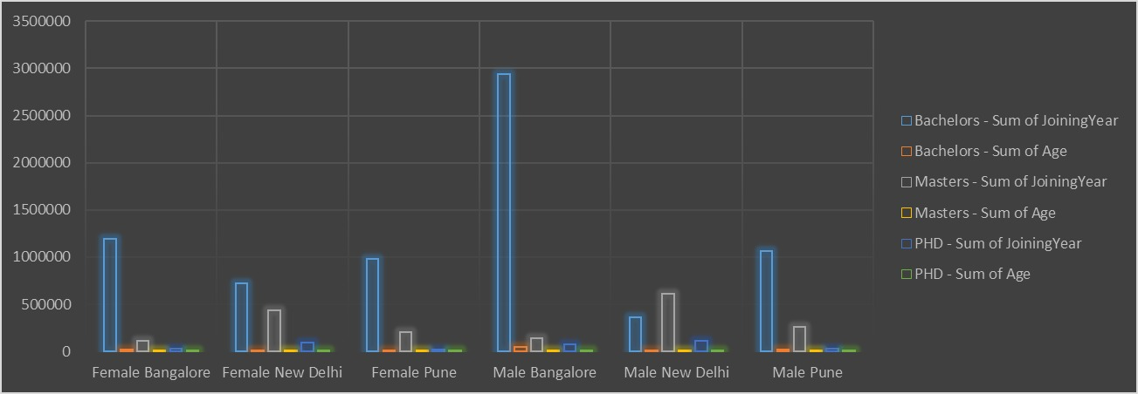
RESULTS
11

Slide 12
conclusion
Gender equality in the workplace is crucial for a thriving organization. By fostering indusivity, addressing biases and promoting diversity
◆◆Enhance innovation and creativity
◆◆Improve employee satisfaction and retention
◆◆Boost reputation and competitiveness
◆◆Ensure fair treatment and opportunities

